Slide 1
Core Java
Object-Oriented: Everything in Java is in the form of the object. In other words, it has some data and behavior. A Java program must have at least one class and object.
Robust: Java always tries to check errors at runtime and compile time. Java uses a garbage collector to provide a strong memory management system. Features like Exception handling and garbage collection make Java robust or strong.
Platform-Independent: Java provides a guarantee that to write code once and run it anywhere(at any platform). The compiled byte code is platform-independent, and we can run it on any machine irrespective of the Operating system.

Slide 2
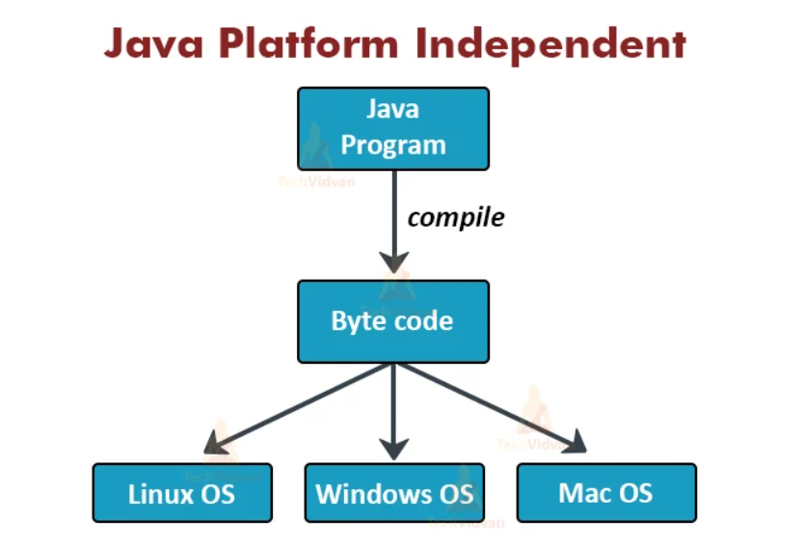

Slide 3
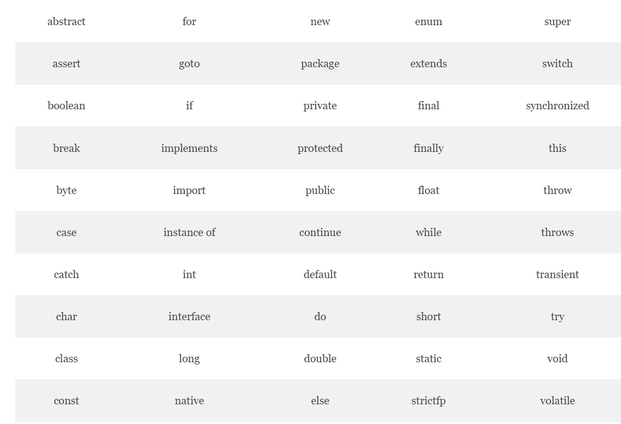
Reserved Keywords

Slide 4
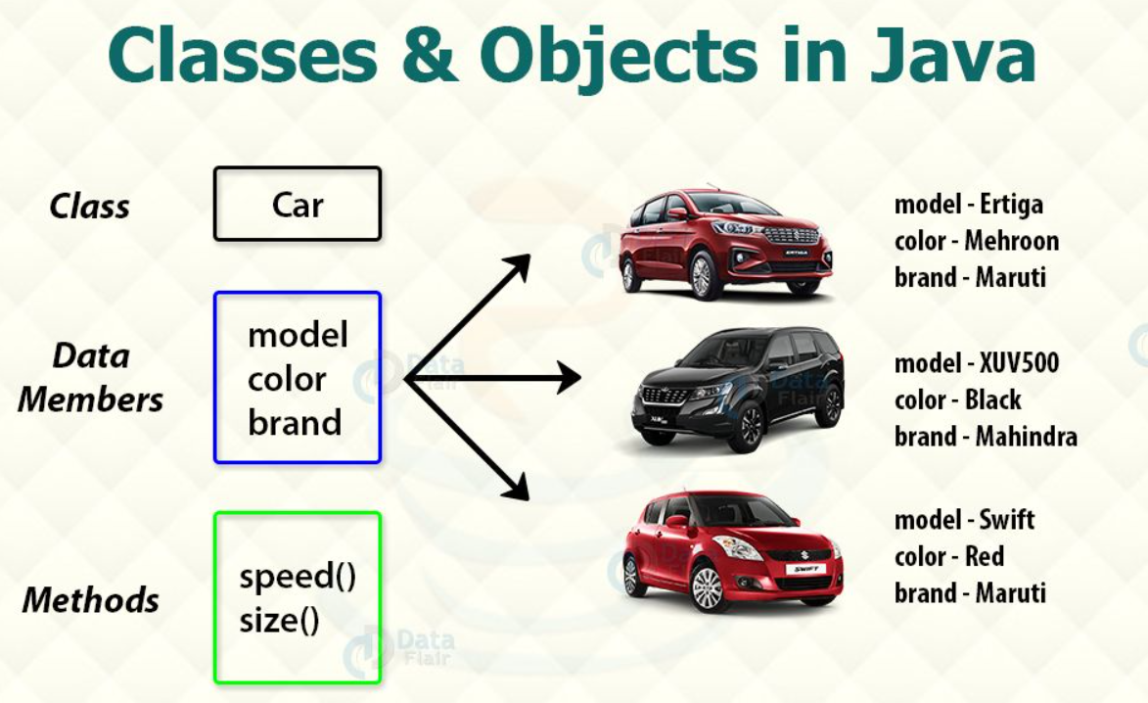
Class and Objects – CAR scenario

Slide 5

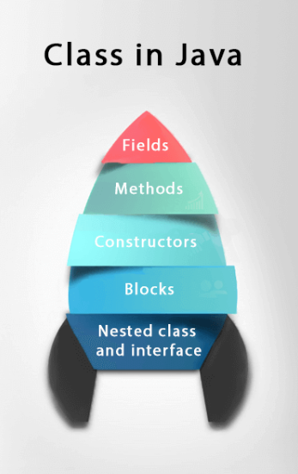
What is meant by a Class and Objects
Class- template or blueprint from which objects are created. It is a logical entity. It can't be physical.
Object - An entity that has state and behavior is known as an object e.g., chair, bike, marker, pen, table, car, etc. It can be physical or logical

Slide 6
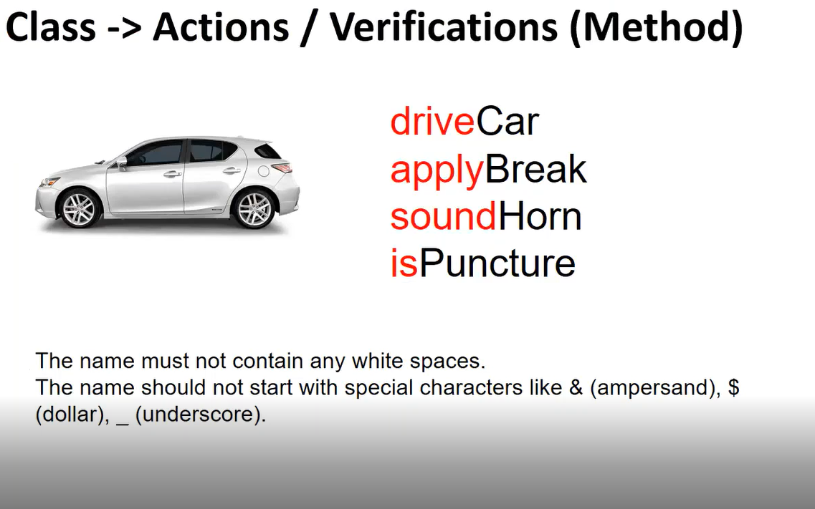

Slide 7
Naming conventions
Class –
Eg – CreateOrder, CreateNewRegistration
Object –
CreateOrder c1 = new CreateOrder();
Methods – CamelCase
enterUserName(), enterPassword(), clickSubmitButton()
Variables –
Int a = 5; String xpathUsername = “<<>>”

Slide 8
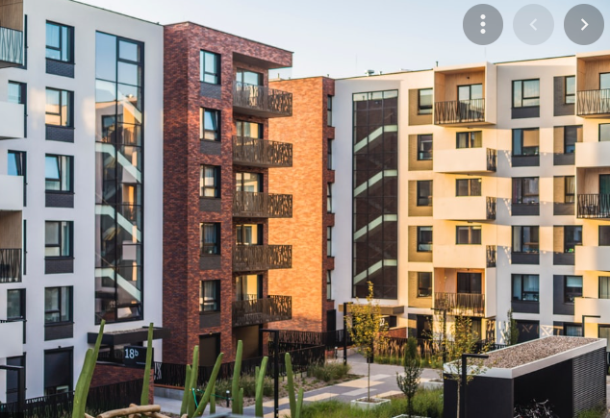

Explanation
Int noOfSqFeets = 1100
Static String builderName = “Ruby”
Int noOfrooms = 3
Actual Building – Object 1
Instance variables
Int noOfSqFeets = 800
Blue Print
Static String builderName = “Ruby”
Int noOfrooms = 2
Actual Building – Object 2

Slide 9
Create a Class in Eclipse
Create a class called Car under a package
Concept of Package - Grouping of all similar classes
Create a method called driveCar
Syntax –
Access specifier/modifier return type methodName()
Shortcut to create any method–
Ctrl+space Enter
Create a main method and create a Object for a Car. Main method is mandatory to execute any Java program
Car myCar = new Car();
Call the method using myCar object.

Slide 10
Creating objects from different class
Now create another class called “NewCar” and create a main method here and create a object of Car class. Explanation about Public access modifier

Slide 11
Purpose of a Method
Methods – For Reusable purposes
Written only once and used whenever it is needed
Code maintenance is easy when we write code in a method

Slide 12
Access Modifier/Specifiers
Types:
Private
Default <No modifiers>
Protected
Public

Slide 13

Private access modifier
Private access modifier provides more security
we can able to access that only if we have privileges

Slide 14

Private Access Modifier
Eg :
Your Own Car.
You are the only one who can access this car.
If you want to give access you want to provide the privileges to others

Slide 15

Default Access Modifier
Default Access Modifiers provides access to a group of members within the same package
Whoever within the same package can access this
Eg – OFFICE CABS
Same organization people can access the cabs

Slide 16
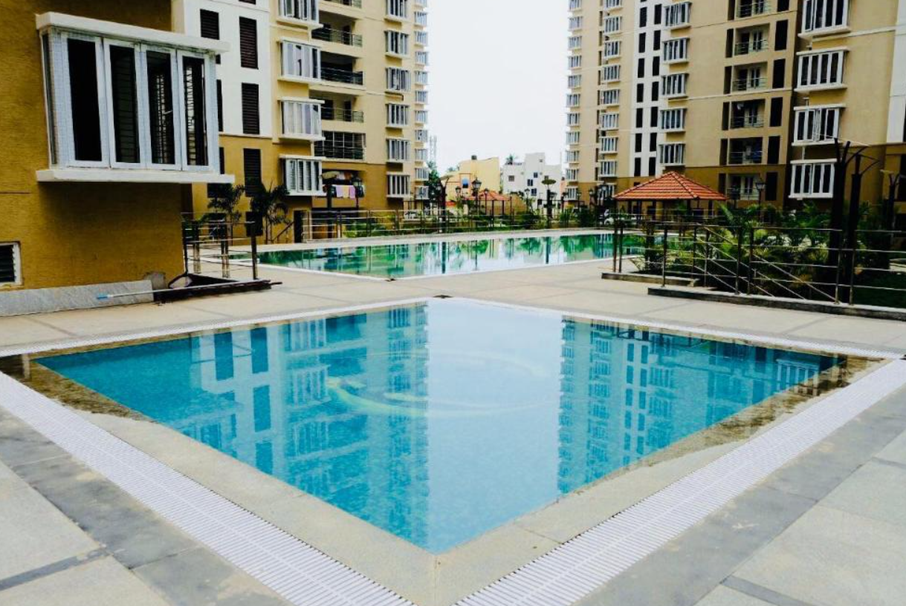
Protected Access modifier
Any one within the same Community can access this and the owners relatives can access this
Any class within the same package and class which is having a relationship via inheritance
Eg –
Swimming pool in Apartments
All Owners can access and the Parents/Relatives can access it

Slide 17
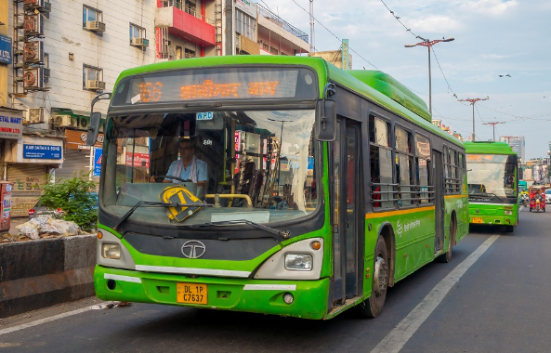
Public Access Modifiers
All classes can access the members
All classes within the package and outside the package can access the members within the same project
Eg –
Public transport can be used by any one within the same state
No restrictions are there to allow peoples

Slide 18
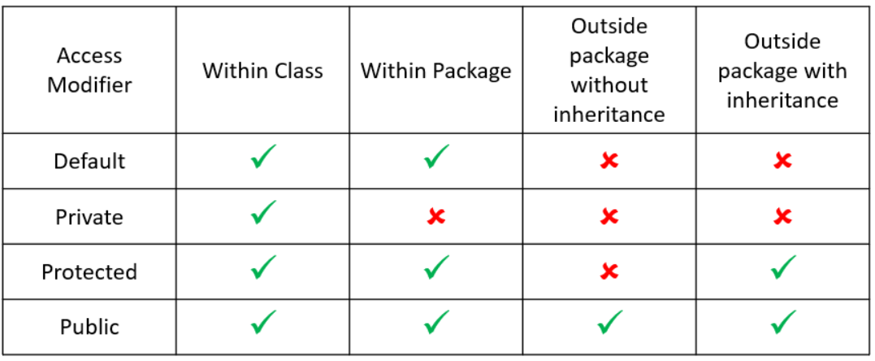
Comparison

Slide 19
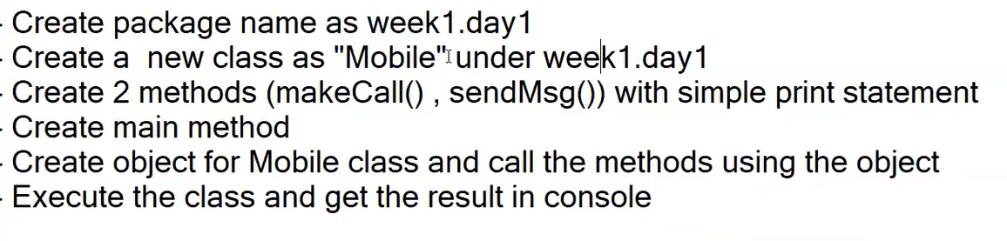
Home Work
Note: Think of any private access member for a mobile

Slide 21
Install JAVA
Refer https://techvidvan.com/tutorials/java-installation/
Recommended to use Java 8 or more

